Slide 1
LF2 Reinforcement-Learning
Team: AliceChienChien

Slide 2
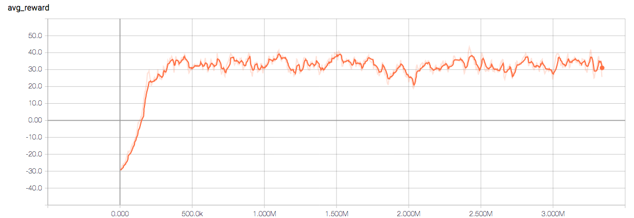
Average Reward

Slide 3
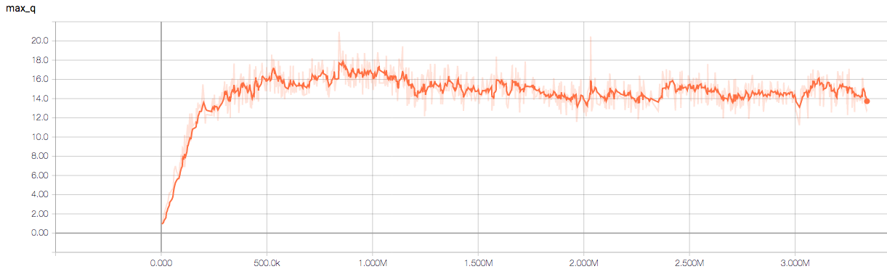
Max Q

Slide 4
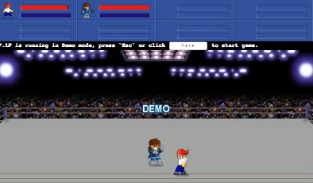
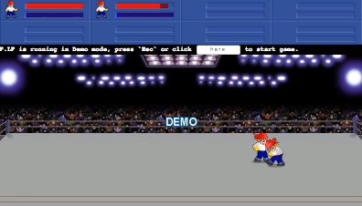
Demo
Episode=100 (Step=50k)
Episode=1190 (Step=668k)

Slide 5
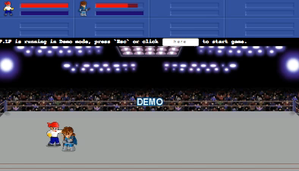
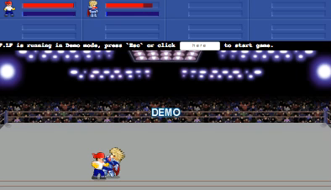
Demo
Episode=1590 (Step=875k)
Episode=5420 (Step=3093k)

Slide 6
Win Rate
Episode=5420 (step=3093k)
Enemy Win Rate(avg 20 ep.)
Bandit 0.95
John 0.65
Deep 0.8
Firen 0.7
Dennis 0.75
Davis 0.3
Freeze 0.95
Woody 0.25
Louis 1.0
Total 0.71

